Slide 1

Use Case- 4: Demand Foresting
Demand forecasting for a Food delivery Company
Case Study Submitted By: Sharan Sasi
sharanssi@gmail.com

Slide 2
Contents
Business Problem Overview
Data Overview
Exploratory Data Analysis (EDA)
Data pre-processing
Forecast result and summary
Insights and conclusion

Slide 3
Business problem overview and solution approach
It is a meal delivery company which operates in multiple cities. They have various fulfilment centers in these cities for dispatching meal orders to their customers. The client wants you to help these centers with demand forecasting for upcoming weeks so that these centers will plan the stock of raw materials accordingly.
The replenishment of majority of raw materials is done on weekly basis and since the raw material is perishable, the procurement planning is of utmost importance. Secondly, staffing of the centers is also one area wherein accurate demand forecasts are really helpful. Given the following information, the task is to predict the demand for the next 10 weeks (Weeks: 146-155) for the center-meal combinations in the test set
Link to the case study: https://www.kaggle.com/datasets/kannanaikkal/food-demand-forecasting

Slide 4
Data Overview
3 Main Datasets:
Weekly Demand data (train.csv): Contains the historical demand data for all centres, test.csv contains all the train features except the target variable.
fulfilment_center_info.csv: Contains information for each fulfilment center
meal_info.csv: Contains information for each meal being served
Train Data Description:
id: Unique ID
week: Week No
center_id: Unique ID for fulfillment center
meal_id: Unique ID for Meal
checkout_price: Final price including discount, taxes & delivery charges
base_price: Base price of the meal
emailer_for_promotion: Emailer sent for promotion of meal
homepage_featured: Meal featured at homepage
num_orders: (Target) Orders Count
Fulfilment Center Data Description:
center_id: Unique ID for fulfillment center
city_code: Unique code for city
region_code: Unique code for region
center_type: Anonymized center type
op_area: Area of operation (in km^2)
Meal Info Data Description:
meal_id: Unique ID for the meal
category: Type of meal (beverages/snacks/soups….)
cuisine: Meal cuisine (Indian/Italian/…)

Slide 5
Data Observation
Train dataset has 456548 rows and 9 columns
Meal info dataset has 51 rows and 3 columns
Fulfilment Center info has 77 rows and 5 columns
Test dataset has 32573 rows and 8 columns
There is no missing values in the 3 datasets
Final merged dataset has 456548 rows and 15 columns
There are no duplicate values in the merged dataset
There are 14 Different food categories in the dataset. Among the food categories, Beverages has the highest number of orders
There are 4 different cuisines in the dataset, with Italian cuisine as the highest ordered one
Centers are divided into 3 categories, Type A, B and C, We have more type A centers in the dataset
Approx 260 is the average orders per week, there are some week it gone up to 24k orders per week
There are 51 cities across 8 regions in the dataset

Slide 6
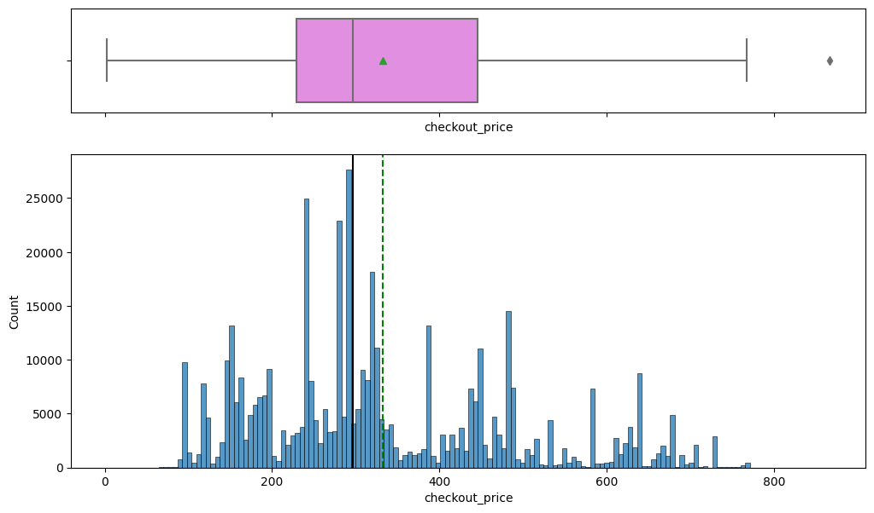
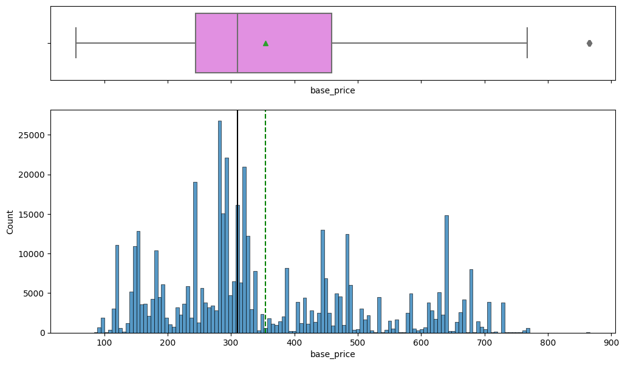
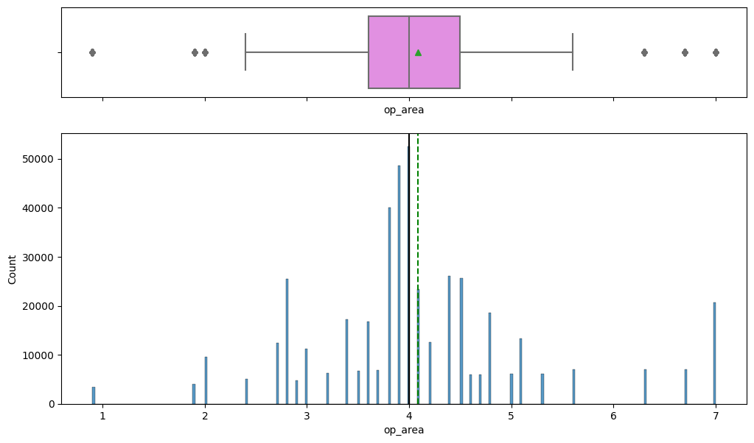
Exploratory Data Analysis (EDA)
Univariate Analysis: Let’s check the distribution of continuous variables
Check-out Price
Base Price
Operating Area
Mean check-out price is 300 and the distribution is little right skewed
Base Price also follow a similar pattern as Checkout price, with mean price at 300 and little right skewed
Operating area is the area of operation of each centers. Average area of operation is 4 sqkm.

Slide 7
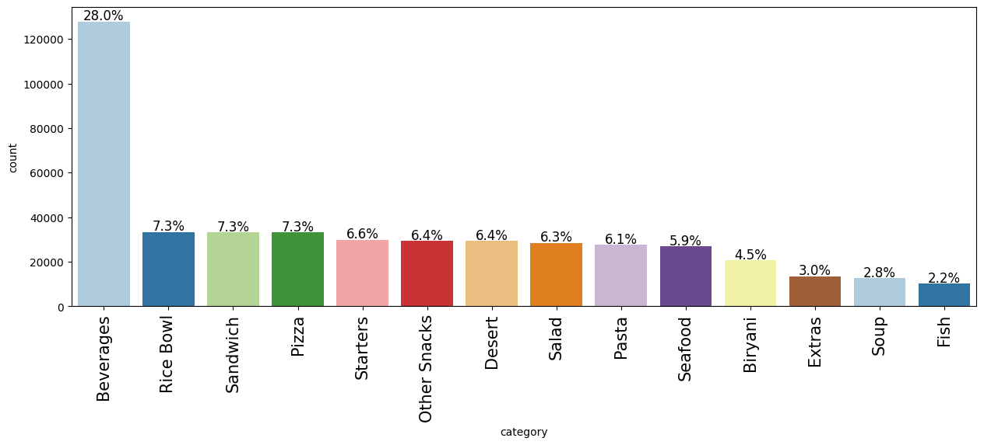
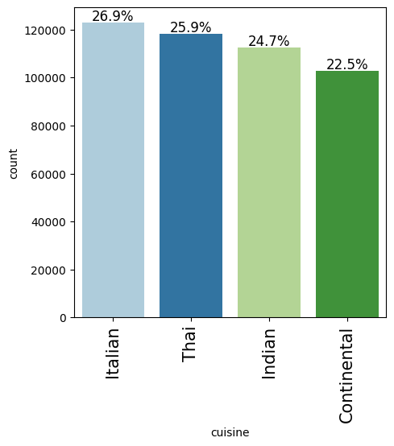
Exploratory Data Analysis (EDA)
Univariate Analysis: Let’s check the distribution of categorical variables
Category
Cuisine
Beverages has the highest number of distribution, followed by rice bowl and sandwich. Least count is for Soup and Fish Category
Distribution of cuisines are somewhat equally split. With Italian having more frequency of orders

Slide 8
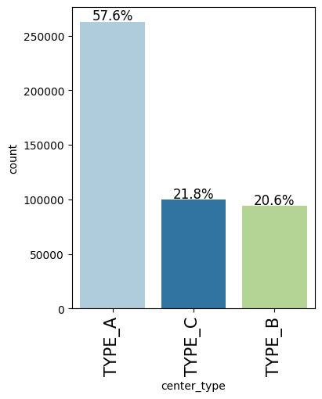
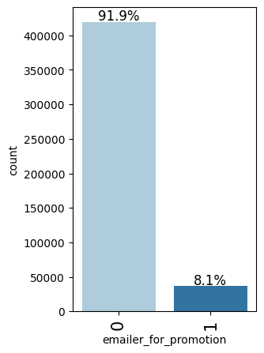
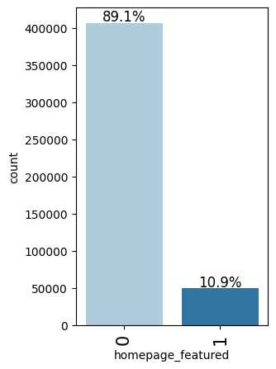
Exploratory Data Analysis (EDA)
Univariate Analysis: Let’s check the distribution of categorical variables
Center Type
Email promotions
Featured in homepage
Most number of datapoints is from Type A center. Which also mean most of the centers are in Type A
Email promotions for meals is done around 8%
Around 11% meal has featured in the homepage

Slide 9
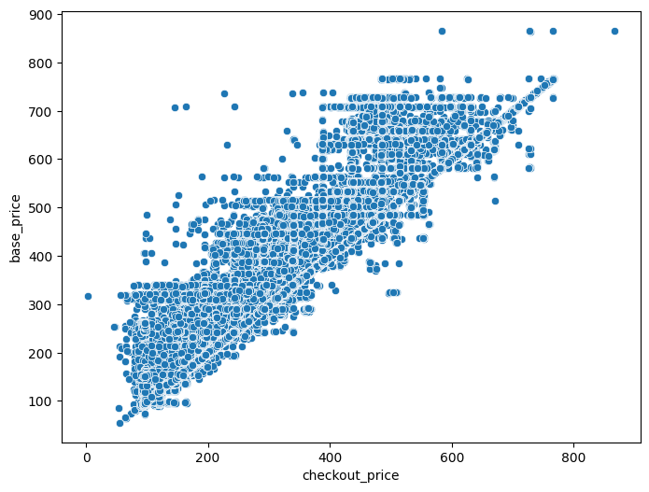
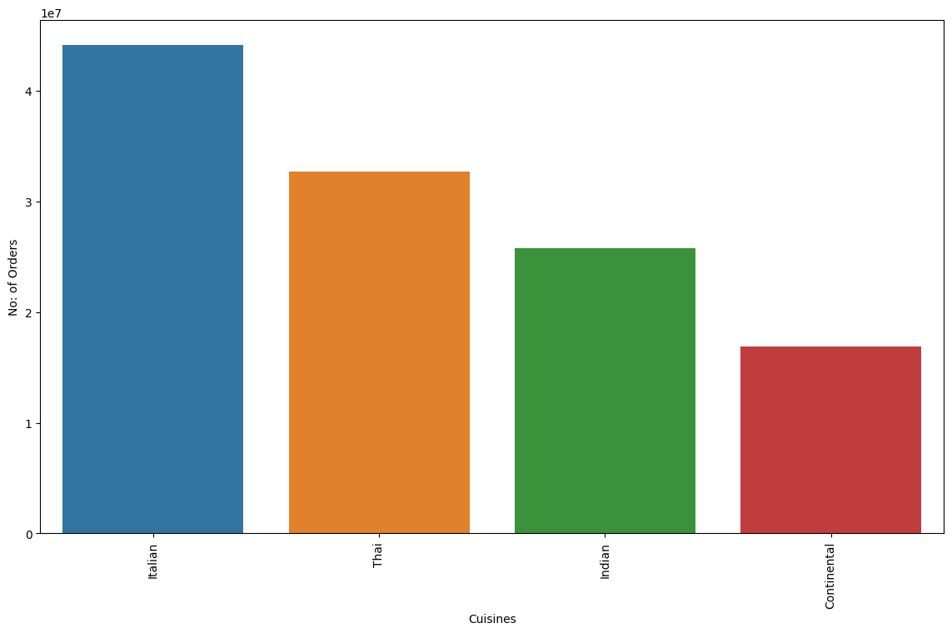
Exploratory Data Analysis (EDA)
Bivariate Analysis
CheckOut Price vs Base Price
Cuisine vs Num of Orders
We can see from the scatterplot that Checkout price and base price are linearly correlated
More number of orders is for Italian followed by Thai

Slide 10
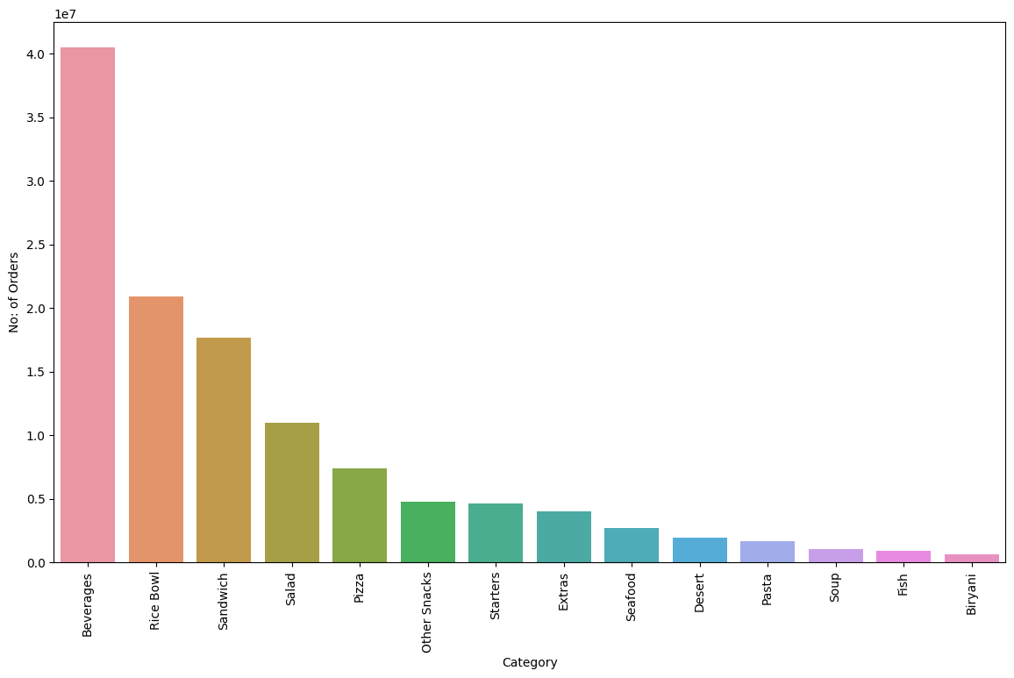
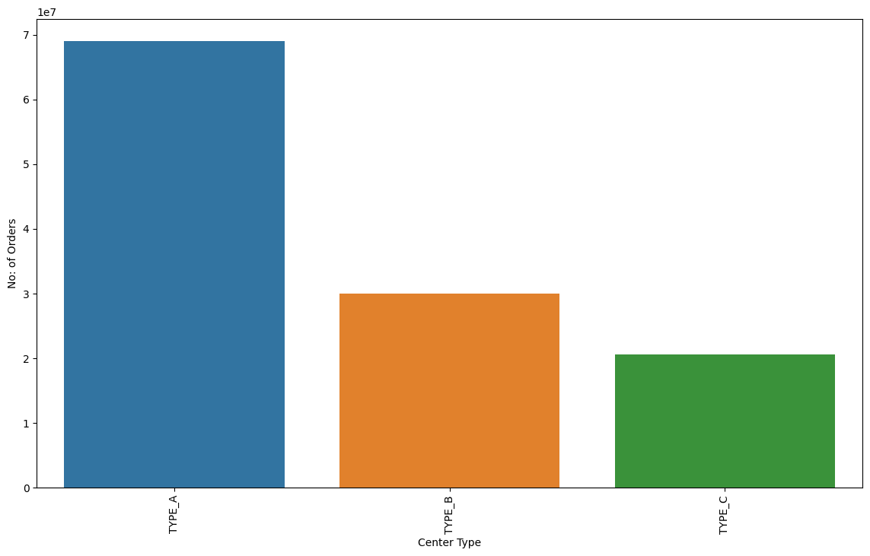
Exploratory Data Analysis (EDA)
Bivariate Analysis
Category vs Num of Orders
Center Type vs Num of Orders
More orders is for Beverages category, then followed by Rice bowl. Least order is for Fish and Biriyani
More number of orders is from Type A center

Slide 11
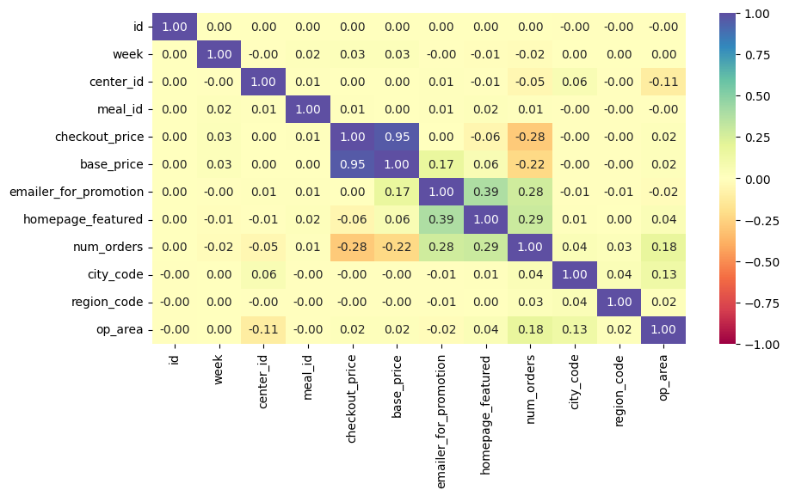
Exploratory Data Analysis (EDA)
Correlation Check
* Base Price is highly correlated with checkout price (95%), so we will drop one of the variable
* Very less correlation among other features

Slide 12
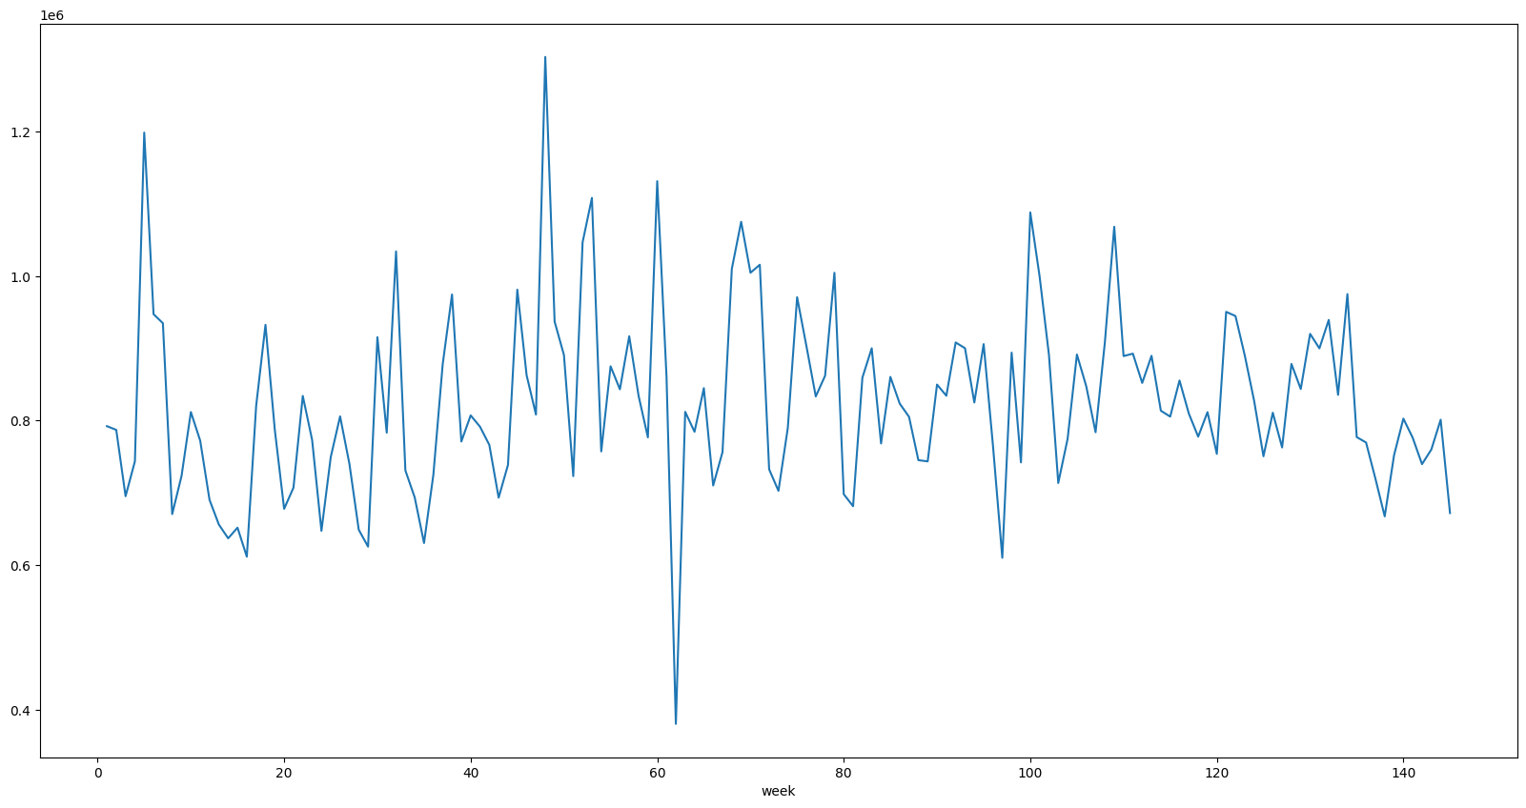
Exploratory Data Analysis (EDA)
Time-series distribution of Num of Orders across weeks
* Data doesn't follow a trend across weeks, it is more of peak and valleys without a linear trend
* No seasonality or cyclical nature visible from this chart, will plot year-on-year chart and confirm on this

Slide 13
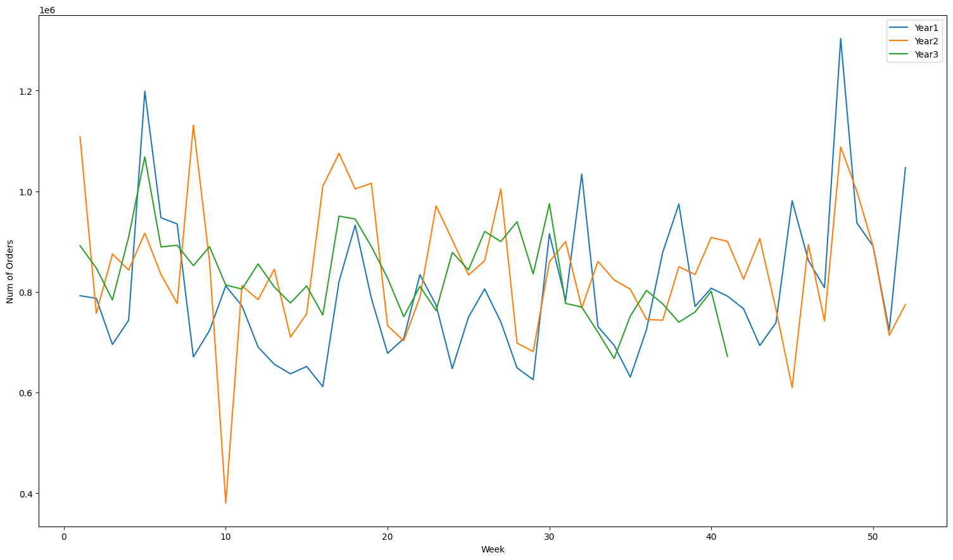
Exploratory Data Analysis (EDA)
Year on Year Time-series distribution of Num of Orders in weekly
Assumption here: 52 weeks is taken as one year, so we are almost 3 years of Data with us
Patterns of seasonality identified in the time distribution

Slide 14
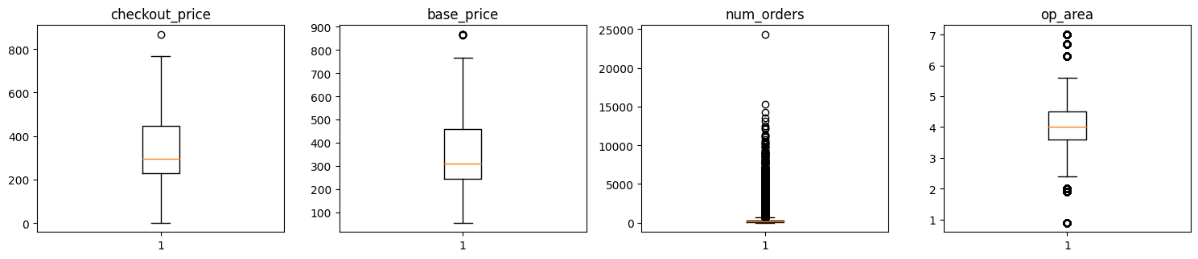
Data Pre-processing
Outlier Check
There are quite a few outliers in the num_orders data.
However, we will not treat them as they are proper values

Slide 15
Data Pre-processing
Feature Engineering
Added Recurring week as a variable along with continuous week value (assumption: every 52 week is considered as one year)
Created Dummy variables for below categorical variables:
emailer_for_promotion
homepage_featured
Category
Cuisine
center_type
Dropped Id column, because it is redundant
Dropped Base price as it is highly correlated to checkout price

Slide 16
Data Pre-processing
Data Preparation before modeling
We want to forecast the num_orders.
We'll split the data into train and test to be able to evaluate the model that we build on the train data
Test data will be split from training set for model validation is based on week number. Week 135 to 145 will be our test set (validation set)
How data is split to train and test here?
Training Dataset
Original Test set
Week1 | Week2 | Week3 | . | . | . | Week135 | . | week144 | Week145
Week146 | . | Week154 | week155
We won’t be able to get the model performance on this set as we don’t have actual data available to compare the forecasted result
This is significant for identifying the best performing models. This is like a validation set
Test Set
This test set is used for validating the model results and selecting the best performing model based on different performance metrics

Slide 17
Model Performance Summary
Model Building Process:
We'll fit different models on the train data and observe their performance.
R-square - Coefficient of determination is used to evaluate the performance of a regression model. It is the amount of the variation in the output dependent attribute which is predictable from the input independent variables.
Along with R-square, Adj R-square, MAE, RMSE and MAPE will also be used as performance metric
Models Used:
Linear Regression
Decision tree regressor
Random forest regressor
Gradient Boosting regressor
Xgboost regressor

Slide 18
Model Performance Summary
Model performance summary on Training set:
Observation:
Decision tree and Random forest are overfitting in training set
XGBoost and Gradient boost works okay in training set
Random forest is our chosen model
Model performance summary on Test set:
Observation:
Random Forest and XGBoost are our best model
Random forest performs slightly better than XGboost, so we will choose random forest as our best model

Slide 19
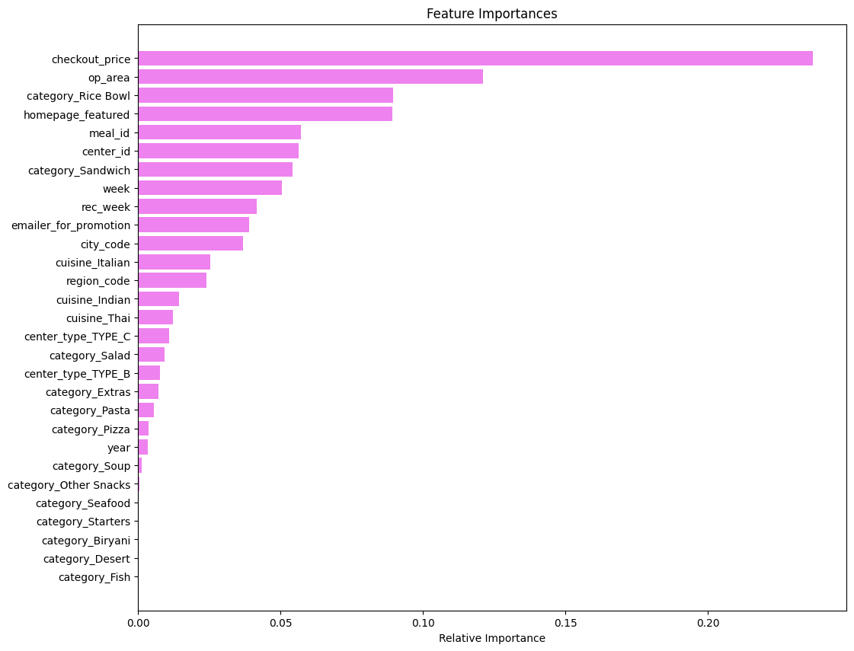
Model Performance Summary
Identifying Important Features from the Model (Random forest model)
Checkout Price is most important features
Operation area is the second most significant feature
Derived feature recurring week is also seems to significant
Homepage feature and email promotion is also significant to forecasted value
Only few dummy variables in category column is significant rest is non-significant

Slide 20
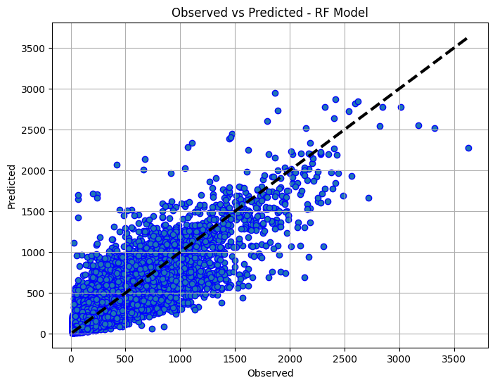
Model Performance Summary
Observed vs Prediction plot
We can see that points are dense on the line where predicted is equal to the observed.
This implies that most of the predicted values are close to the true values with some exceptions as seen in the plot.

Slide 21
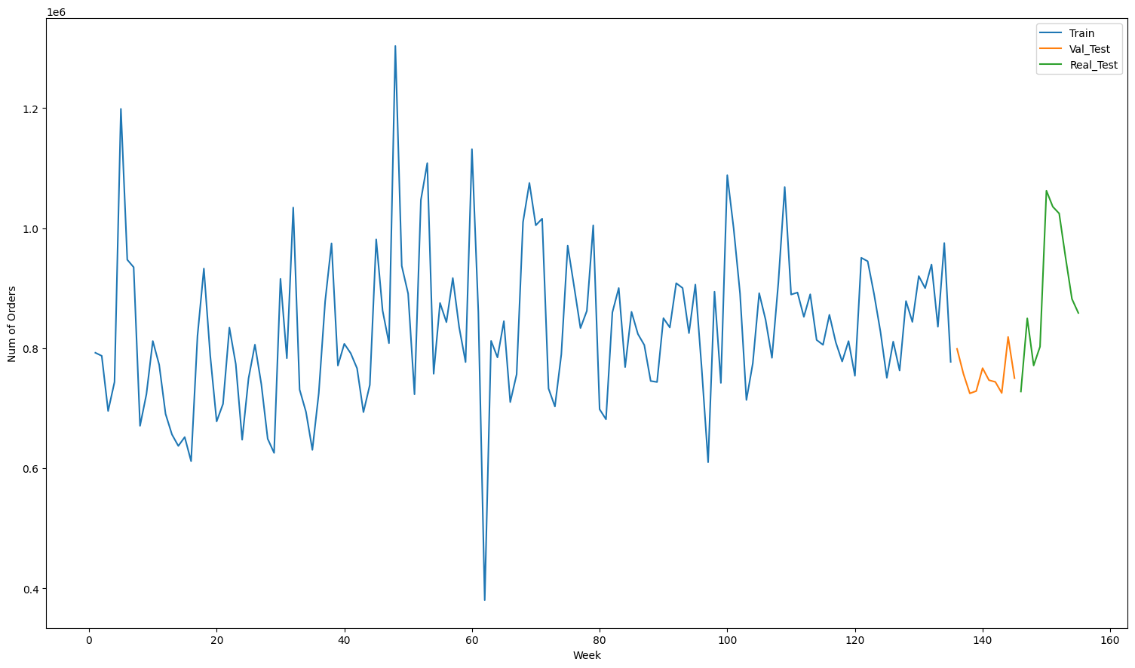
Final Prediction Plot
Predicted value on original test set
Predicted on validation test set
Prediction across all centers for different meal id

Slide 22
Insights and conclusion
Insights from Data:
Checkout Price is the important feature for prediction, Check out Price is the main factor determining the number of orders. The more discounted the checkout price compared to base price chances of meal getting ordered is high.
Operational area is also important feature for prediction. If the area of operation is high, the chances of getting orders are high
The chance for a food to get order is high when it is featured in homepage
Email promotion also has an impact in getting the meal to be ordered
Italian and Thai are the most ordered cusine. While beverage and rice bowl are the most ordered meal category
Insights from Model:
Using Random Forest and Xgboost model can give you a more accurate prediction of future orders
Random Forest has high r-square value compared to other models

Slide 23
Final insights to the centers for raw material planning
Insights to centers:
Most ordering category will be Beverages and Rice bowl
Most ordering Cuisine will be Italian
Second most ordering cuisine will be Indian
Most ordering Italian meal category will be sandwich then followed by beverages and salads
Most ordering Indian meal category will be rice bowl followed by beverages and desserts
Most ordering Thai food will be beverages
Most ordering Continental food will be Pizza
Center 13 will have highest number of orders

Slide 24
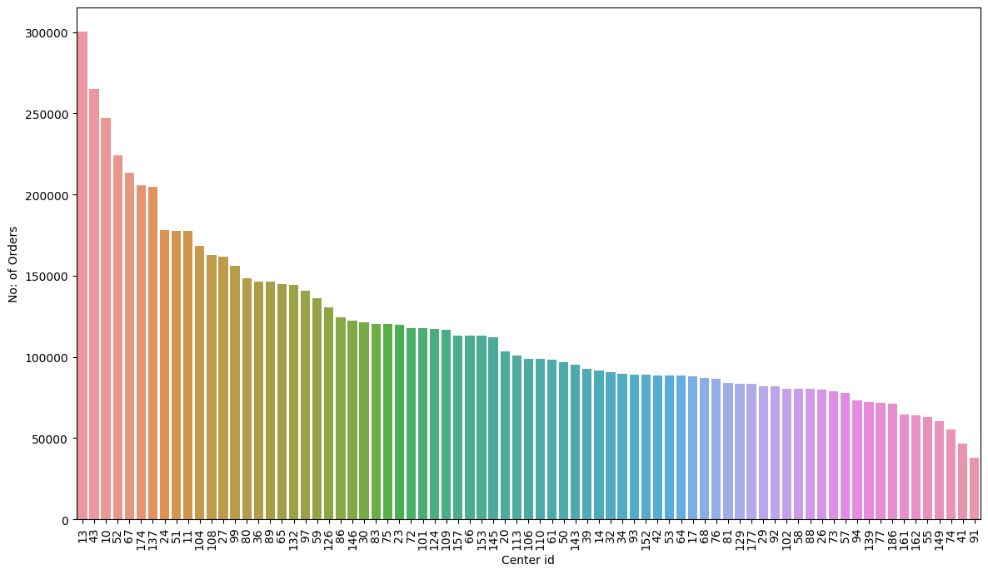
Prediction across centers for raw material planning

Slide 25
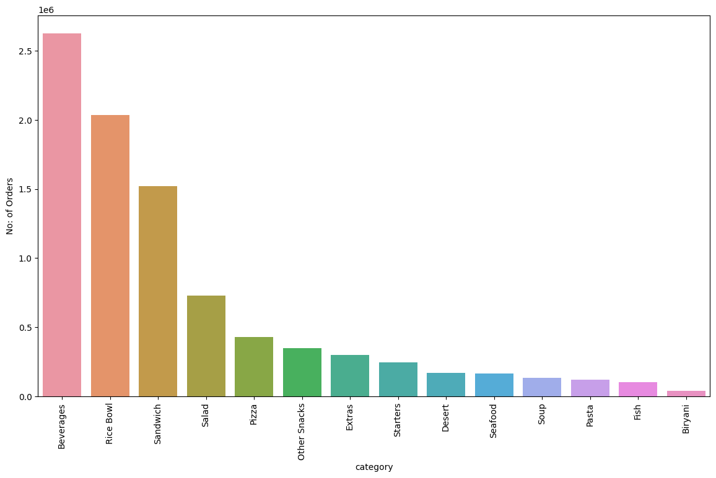
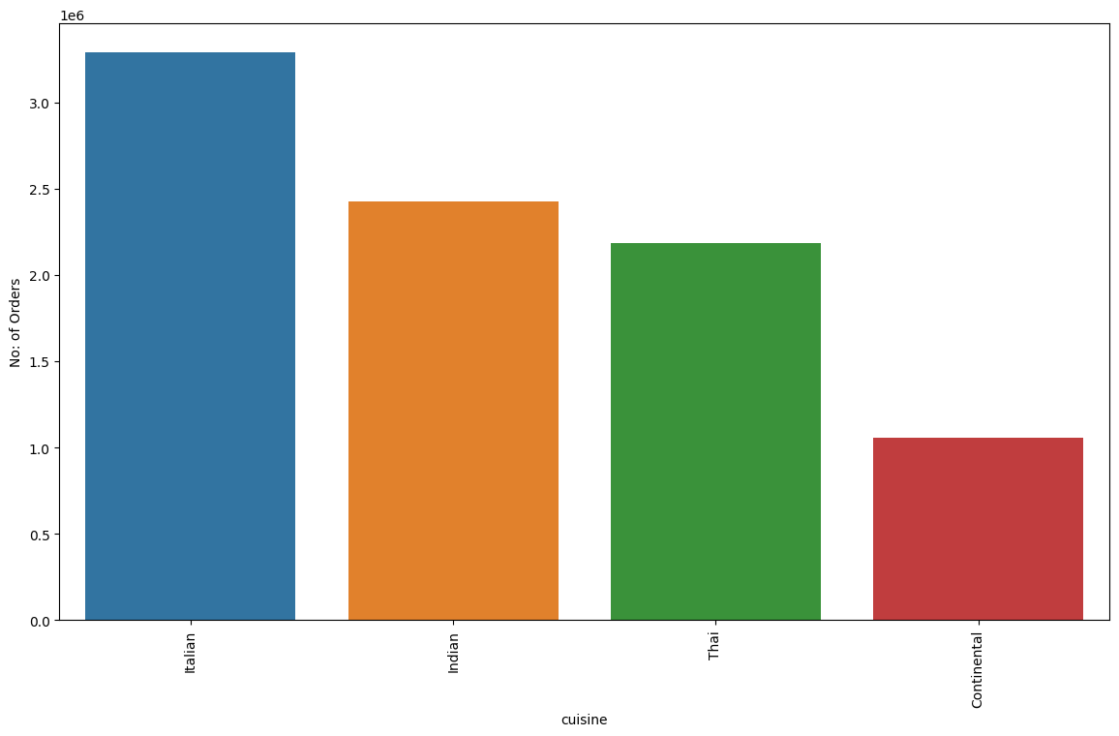
Insights across centers for raw material planning
Category wise orders
Cusine vs Num of orders
Most ordering category will be Beverages and Rice bowl
Most ordering Cuisine will be Italian
Second most ordering cuisine will be Indian

Slide 26
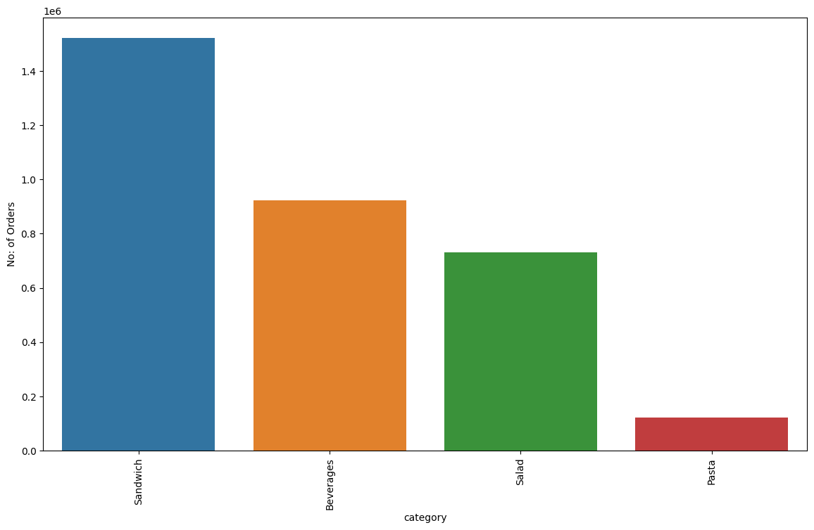
Insights across centers for raw material planning
Most ordered Meal category in Italian cuisine
Most ordering meal category in Indian cusine
Most ordering Italian meal category will be sandwich then followed by beverages and salads
Most ordering Indian meal category will be rice bowl followed by beverages and desserts

Slide 27
Business recommendation for future growth
Insights for Business for increasing order:
Make check-out price more attractive by implementing discounts and promotions
Currently only 10% meals get featured in homepage, increase the number of meals featured in homepage to increase the number of orders
Only 8% email promotions are done so far, we saw that promotions are indeed a contributing factor to the prediction, so increase the promotion in coming weeks to increase orders
Increase Type B and Type C centers

Slide 28

Thank you
Sharan Sasi
This Photo by Unknown Author is licensed under CC BY-SA-NC

